Slide 1
Living Obituary
Annabelle
A gathering
They are still here.

Slide 2
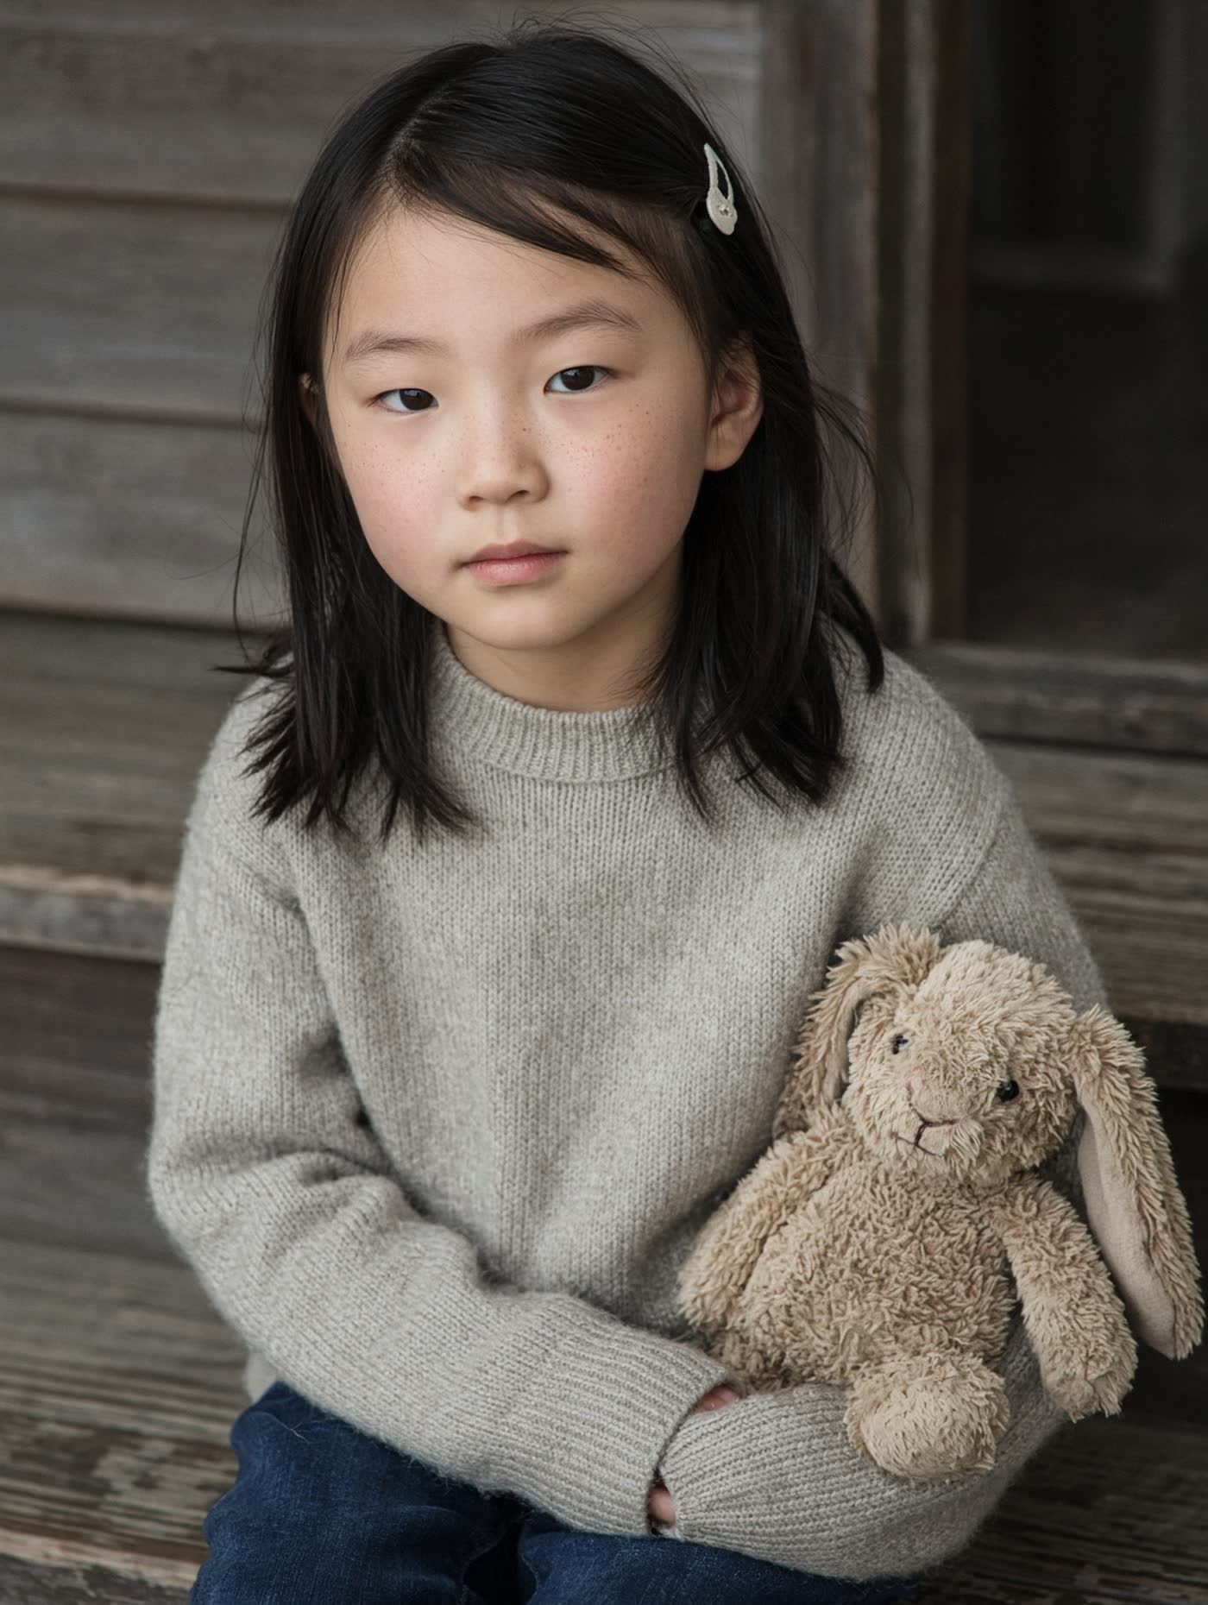
The sitting she approved. Pip in her lap. Window light at home, not the clinic.

Slide 3
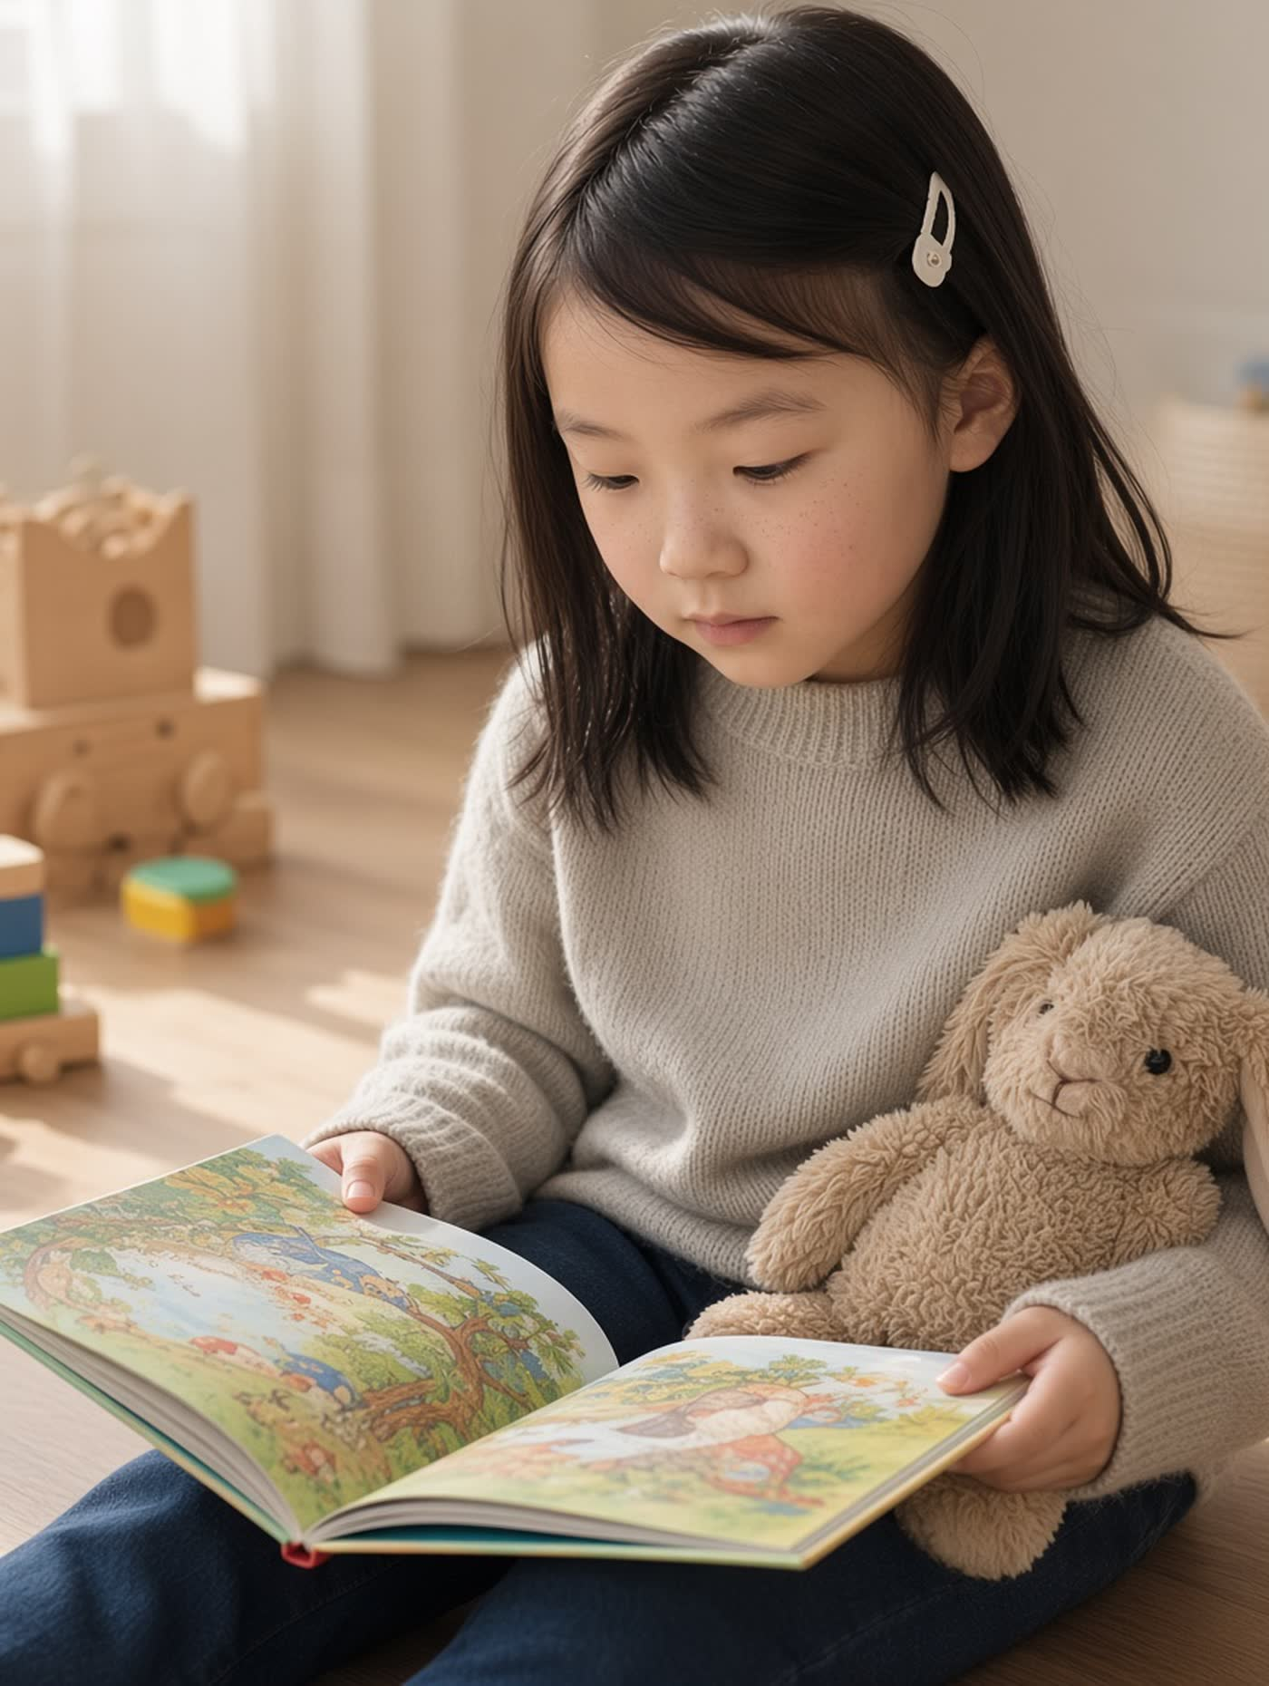
The playroom at home. She drew the yellow dog and would not let anyone throw the page away.

Slide 4
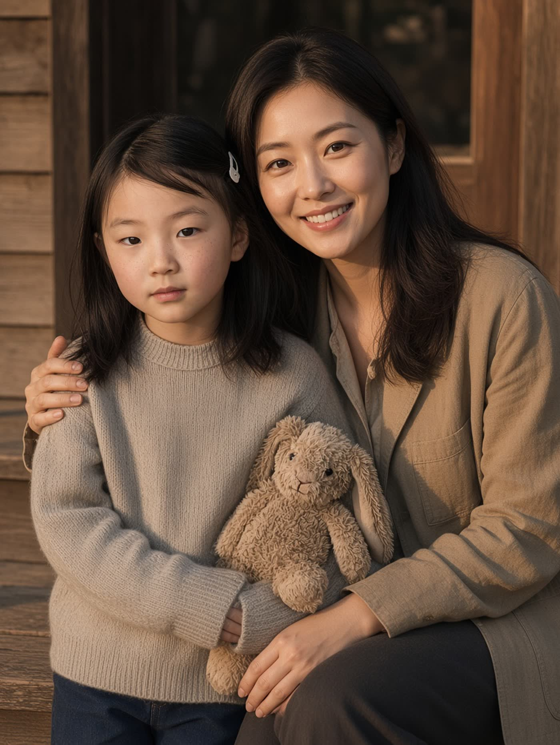
The living room. Claire reading. Not a treatment room. She asked for this one in the collage.

Slide 5
A good day. Bubbles on the stoop. Pip on the step.

Slide 6
Sunday couch. Claire, Daniel, Annabelle, Pip. She still laughs at the phone.

Slide 7
Annabelle
They are still here.
Living Obituary

